Slide 1
IoT in COVID BLE based Contact Tracing
Abdul Saboor
Frankfurt University of Applied Sciences
Frankfurt, Germany
Matriculation Number 1322460
Email: abdul.saboor@stud.fra-uas.de
Notes:
Good Evening every one, My Topic is IoT in Covid , for this very broad topic , today I will discuss about the Ble base Contact tracing

Slide 2
Agenda
Introduction
COVID-19
Contact Tracing
IoT enabled Contact Tracing
Centralized Contact Tracing
Decentralized Contact Tracing
Proximity Measurement Technologies in IoT for Contact Tracing
BLE based Contact Tracing
Contact Tracing Protocols
BlueTrace
DP-3T
PEPP-PT
Apple/Google
Challenges
Social considerations
Technology considerations
Security considerations
Privacy considerations
Conclusion
Acknowledgement
References
Notes:
Content reading
1:Here is the Agenda : In introduction is about covid and contact tracing and and how IoT enable the Digtal Contact Tracing ​
2: After that we Two are Proposed related to Privacy issue : Centralized and Decentralized​
3 : we Will See Avaible teconloigies in IoT for Proximity detection ​
4 : At 4th we will discuss some already implemented protocol in Contact Tracing ​
At last we will have a short look regarding the challenges that has been related to Contact Tracing ​

Slide 3
COVID-19
SARS-CoV-2 Virus and the associated disease COVID-19 .
a severe global pandemic
botched down the world’s economy
Negative impact on human mobility
to minimize the disease’s spread, preventive measures include:
smart lockdown strategies
social distancing
contact tracing
Notes:
SARS-CoV-2: Severe acute respiratory syndrome coronavirus 2a severe global pandemic ​
botched down the world’s economy​
Negative impact on human mobility​
preventive measures are suggested to Governments are smart lockdown social Distancing And Contact Tracing ​
And For medicial Staff it is Advised to Wear mask snatize the hand and maitian the Hygiene is advised ​

Slide 4
Contact Tracing
Contact tracing is an essential component
to support the early identification of new cases among the population and
to contain outbreaks of the disease like COVID-19.
Traditional approaches of contact tracing:
Manual and
Semi manual
Pitfalls of manual contact tracing:
extremely time-consuming,
inefficient,
highly error-prone and
not scalable.
Notes:
contact tracing is to identify, track, and inform the past contacts of an infectious person to support the early identification of new cases among the population.​
And help to contain outbreaks of dieses like Covid 19 Once contacts are identified, the person could be asked to self-isolate for safety measures​
Traditional approaches of contact tracing i.e. ‘manual’ & ‘semi-manual, are extremely time-consuming, inefficient, highly error-prone, and not scalable.

Slide 5
Digital Contact Tracing
using smartphone technology
either by using a local Bluetooth connection or the global network of GPS for location tracking.
Digital contact tracing benefits in combating COVID-19 as following.
Effective Diagnosis
Enhanced Diagnosis
Superior Treatment
Lesser Expenses
Reduced chances of mistakes
Notes:
Digital Contact Tracing through Smart phone because Billions Of Smart phone user are in the Gloab​
smartphones have become an intimate device in our everyday life. we always carry th on public In this way, smartphones are the best choice for contact tracing, in which the tracing is only performed when the user is in the public space. At any time, no location or any other information regarding the users is collected or transmitted​
smart contact tracing (SCT) system is introduced by exploiting the Bluetooth Low Energy (BLE) signals on smartphones. BLE is readily available on many smartphones making it ideal for the introduced system​

Slide 6
Illustration of scenarios
Notes:
Here are three senarios of Surivillance : out of them 2 are part of this seminar paper​
1st. Signature generation: The smartphone scans for the environmental features like timestamp and random number to generate a unique signature that can be advertising payload or called encounter message which . The signature will ​
be updated every few minutes ​
ii. Signature broadcasting: The smartphone broadcasts the ​
advertising packet containing the unique signature pe​
riodically according to the advertising interval of Ta. ​
The packet is broadcasted through the non-connectable ​
advertising channels. ​
iii. Signatures Observation: The smartphone scans ​
advertising channels to listen for the advertising packet ​
broadcast by the neighboring smartphones In The scanning ​
is performed in between the broadcasting event. ​
iv. Proximity sensing: The smartphone measures the RSS ​
values and uses them to estimate how close it is to the ​
neighboring smartphones. It is assumed to be in proximity ​
when the distance is less than 2 m.​
4th Physical distancing alert: The smartphone triggers a real​
time alert to warn the user to keep a healthy distance ​
from nearby users when it detects any physical distancing ​
Violation​

Slide 7
Digital Contact Tracing is IoT enabled Contact Tracing
A framework in which smartphones close contacts with other ones, running the same contact tracing app.
Architecture of the digital contact tracing framework is of two types:
Centralized Contact Tracing
Decentralized Contact Tracing
Notes:
Centralized and Decentralized comes into Question when we are discussing about the data security and privacy preference During the process of Contact Tracing ​

Slide 8
Centralized Contact Tracing vs Decentralized Contact Tracing
Amount of information:
A lot/All information on one cloud server
Data Ownership:
property of the user
Decision making:
at the server side
Primary benefit:
application’s efficiency
Amount of information:
Pieces of necessary information at each node
Data Ownership:
partial or full usage rights to the server
Decision making:
on user devices
Primary benefit:
User’s privacy
Notes:
Esko mt urao….

Slide 9
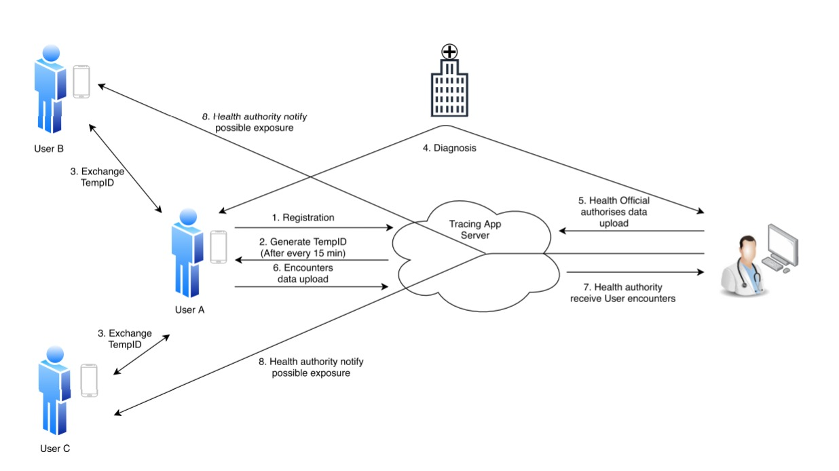
Centralized Contact Tracing Architecture
Figure 1: Tracing apps centralized architecture
Notes:
During Proximity detection, when users come in close contact over a certain period, they will exchange the ‘Encounter message’ through BLE, which contains the exchange of TempID and Transmit Power (TxPower). Each device also records the RSSI and the timestamp of the message delivery. All encounter messages are stored locally and uploaded to the server. Infected users voluntarily inform the server and also provide health data to the server for verification. In a centralized architecture, the server is the unit that computes the likelihood of getting infected and sends an exposure notification to each user deemed highly likely to have been infected.

Slide 10
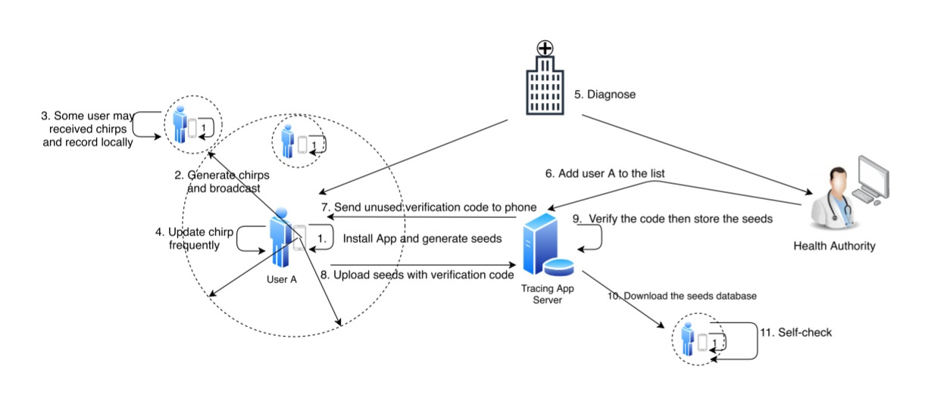
Decentralized Contact Tracing Architecture
Figure 2: Tracing apps Decentralized architecture
Notes:
In a decentralized approach, users are not required to register with the server. During the close interaction between the users ‘chirps’ have been shared among the users. Only infected users voluntarily upload their information of seeds and the relevant time information to the server. The server broadcasts the seeds of infected users to all other users or the app users can download any seeds uploaded by infected users from the server. Based on downloaded seeds from the server, users’ app using pseudorandom calculations based on the seeds and discrete-time intervals between the start and expiry time device computes the likelihood to become infected and creates an exposure notification for the user. Sometimes these exposure notifications are also sent to the cloud server to collect statistics.

Slide 11
Proximity Measurement Technologies in IoT for Contact Tracing
1.5 meters of proximity with sufficient exposure to any COVID-19 patient may result in infection.
Therefore, correct estimation of distance between two people and the duration of exposure is vital.
GPS, Bluetooth and WiFi etc. help to estimate the physical distance and the extent of interactions.
Notes:
In terms of COVID-19, 1.5 meters of proximity with sufficient exposure to any COVID-19 patient may result in infection. Therefore, correctly estimating the distance between two people and the duration of exposure is vital. Different technologies such as GPS , Bluetooth , and WiFi help to estimate the physical distance and the extent of interactions.

Slide 12
Proximity Measurement Technologies in IoT for Contact Tracing
WiFi - potential feature ‘positioning’, proves it very effective for contact-tracing purposes in an indoor environment. Other benefits include: High accuracy, low-cost maintenance and easy deployment.
Global Positioning System - Modern smartphones are GPS enabled. Its global availability can be used for contact tracing. The social distancing between the public can also be significantly enhanced by using GPS.
Notes:
WiFi - Especially in an indoor environment such as multi-story building, airports and parkings etc, among the Wifi communication technologies potential ‘positioning’, proves it very effective for contact-tracing purposes. High accuracy, low-cost maintenance and easy deployment makes it convenient to use Wifi Hardware facilities.
Global Positioning System - Modern smartphones are GPS enabled, which can be used for contact tracing as well. The social distancing between the public can be significantly enhanced by using GPS technology as Amazon and DHL are using Unmanned Aerial Vehicles (UAVs) based on GPS technology, to deliver the products to the customer’s doorstep. The other benefit of GPS is its global availability.

Slide 13
A survey of wireless technologies used in IoT​
Notes:
In order to design a wireless application for contact tracing, proximity detection, or/and user ​
location tracking, one needs first to understand what kind of wireless technologies are currently ​
available and what design constraints are essential, such as energy effificiency, spectrum availability, ​
or low-cost low-power constraints.​
IoT domain technologies were classified via operating frequency ​
bands, protocols versus enablers, range-based classification (i.e., short-, medium- and long-range ​
operated solutions), data rates (low vs. high rates), and power-range classifification (e.g., low-power vs. ​
high-power operation). ​
contact tracing based on user location is only one ​
area

Slide 14
BLE based Contact Tracing
Bluetooth BLE is a global short-range radio communications standard with a large ecosystem and with strong potential for the success of contact tracing applications.
Most of the contacts tracing apps utilize BLE for contact tracing.
A simple and easy to implement methodology.
Examples: EasyBand Accent wristband BLE-enabled device and TraceTogether App.​
Notes:
BLE is a wireless personal area network technology; in comparison to Classic Bluetooth, avaible in smart phones since 2015 BLE is ​
intended to provide a reduced power consumption and cost by operating at a similar communication ​
range. This short-range technology, currently operating at ranges of up to a few hundred meters, ​
is known as one of the most suitable for smartphones, which can provide proximity information useful ​
for contact tracing. By using the BLE wireless radio signals for proximity information, users equipped ​
with BLE-enabled devices can be notifified if they were possibly infected.​
every time the contact-tracing app comes within the proximity of another app, it will locally save their information mutually. They may volunteer to share this contact information later with the health department.​

Slide 15
BLE based Contact Tracing
Bluetooth Low Energy (BLE) - has become a dominant wireless communication protocol for proximity tracking.
In the BLE protocol definition, 40 channels are used to transmit messages.
The duration for transmitting messages is extremely short to save battery power.
Three channels (i.e., 37, 38, and 39) for broadcasting advertisement messages. The Received Signal Strength Indicator (RSSI) from these three channels can be used for estimating the target’s proximity.
The BLE advertising rate can be set up to 50 Hz.
The transmission power for BLE beacons is also set from 0 dBm to −75 dBm.
To reduce power consumption, BLE advertising rate and transmission power are usually set to less than 10 Hz and −16 dBm, respectively.

Slide 16
Global Deployment of the Contact-Tracing Apps for ​ COVID-19​
Notes:
Currently, there are more than 50 contact-tracing applications used in more than 30 countries​
the Corona-warn-app from Germany and Immuni from Italy, with both of more than one million ​
downloads from Google play​

Slide 17
Some State-of-the-art approaches for contact tracing in COVID-19 using BLE technology, include: BlueTrace DP-3T PEPP-PT Google/Apple
Contact Tracing Protocols

Slide 18
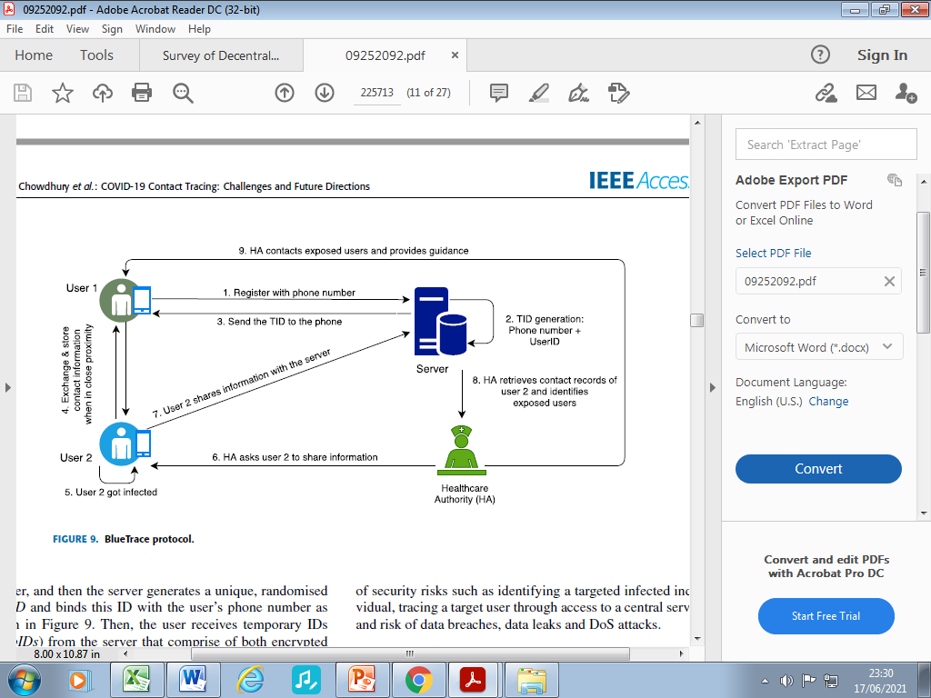
BlueTrace
Figure 3: BlueTrace Protocol
BlueTrace is an open-source protocol that is utilized in Singapore’s TraceTogether app. It adopts the BLE technology, where devices exchange their ephemeral IDs via broadcast and log all encounters in their history logs. When a user is diagnosed as positive, his/her history logs are sent to a central authority, using a secure connection.
The reconciliation function and exposure notification are performed at a centralized location, i.e., BlueTrace is considered a hybrid solution.
The main cryptographic primitive involved in the computation of the ephemeral IDs is AES-256-GCM.
Notes:
BlueTrace is an open-source protocol that is utilized in Singapore’s TraceTogether app. It adopts the BLE technology, where devices exchange their ephemeral IDs (i.e., beacons) via broadcast and log all encounters in their history logs. When a user is diagnosed as positive, his/her history logs are sent to a central authority, using a secure connection. Even though BlueTrace leverages the decentralized architecture, the ephemeral IDs are generated by the central authority and distributed to the individual devices. As such, the reconciliation function and exposure notification are performed at a centralized location, i.e., BlueTrace is considered a hybrid solution. The main cryptographic primitive involved in the computation of the ephemeral IDs is AES-256-GCM.

Slide 19
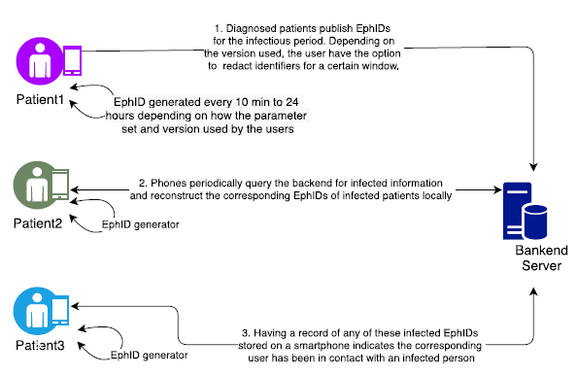
DP-3T
Figure 4: DP-3T Protocol
Decentralized Privacy-Preserving Proximity Tracing protocol that leverages BLE technology to track and log encounters with other users.
The contact logs are never transmitted to a central authority, but they are stored only to the client’s device.
When a user tests positive, his/her ephemeral IDs are transmitted to the central authority.
The IDs are generated with symmetric key protocols, such as HMAC-SHA-256 and AES128-CTR.
The project is completely open-source.
Notes:
European researchers proposed the Decentralized Privacy-Preserving Proximity Tracing protocol that leverages BLE technology to track and log encounters with other users. The contact logs are never transmitted to a central authority, but they are stored only to the client’s device. When a user tests positive, his/her ephemeral IDs are transmitted to the central authority. The IDs are generated with symmetric key protocols, such as HMAC-SHA-256 and AES128-CTR. Finally, the project is completely open-source.

Slide 20
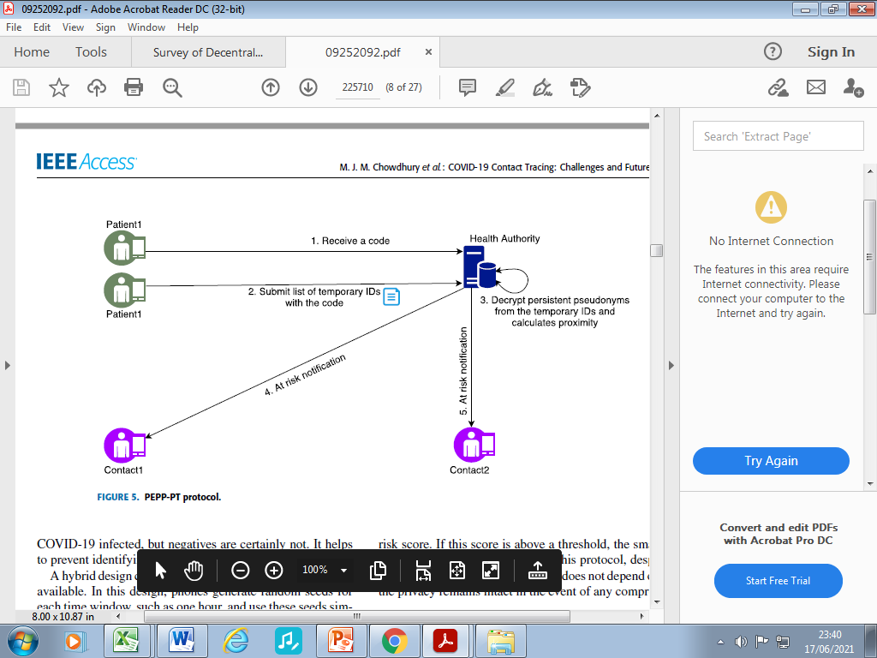
PEPP-PT
Figure 5: PEPP-PT Protocol
Pan-European Privacy-Preserving Proximity Tracing protocol adopts BLE to discover and store locally the ephemeral IDs of devices that are in proximity. Similar to BlueTrace, it uses the hybrid architecture by having the health authorities generate the users’ beacons. As such, a centralized server collects and processes the contact logs from infected users, and performs the reconciliation process in a centralized manner. The main cryptographic algorithm they employ is AES.

Slide 21
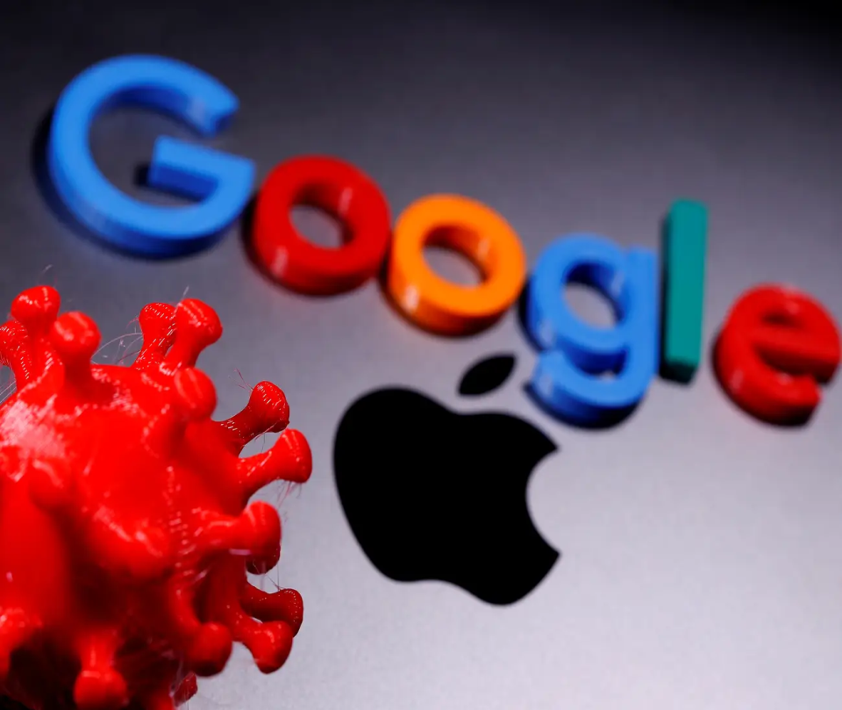
Apple/Google
In April 2020, Apple and Google worked together to build an opt-in and decentralized way of allowing individuals to know if they have come into contact with confirmed cases based on Bluetooth technology.
Similar to DP-3T, the contact tracing logs do not contain any private information, and ephemeral IDs are only stored on the user’s device.
From the cryptographic perspective, they adopt HMAC-SHA-256 and AES-128.
Immuni is the Italian State-sponsored official contact tracing app that leverages the Apple/Google framework.
Notes:
Google and Apple in ​
partnership [20] will launch an exclusive decentralised framework in May ​
Apple and Google partner on COVID-19 contact tracing technology framework [20] (yet to be ​
released in May) - privacy-preserving contact tracing, Bluetooth based, decentralised, free of ​
GPS. Apple and Google tech is currently trading (integrating) with some of the Governments ​
self-running Apps. ​

Slide 22
CHALLENGES
Contact tracing is a surveillance-type application.
In terms of usability, the main challenges are related to energy efficiency and computational cost.
When it comes to privacy and security, the most recurrent threats are user de-identification and user tracking.

Slide 23
Social Considerations
Less User Adaptability
Low Penetration Rate
Require Modern and Hi-tech Infrastructure
Adaptability Rate
India 24% | South Korea 95% | USA 81%
Penetration Rate
Country | App | Penetration Rate
Australia | COVIDSafe | 28.6%
Singapore | TraceTogether | 25%
India | Aarogya Setu | 12.05%
Turkey | Hayat Eve Siğar | 17%
UK | NHS COVID-19 | 28.5%
Notes:
​
The Health Code on Alipay and WeChat used in China has achieved a 63% of the population coverage and 100% on travelers​
Stopp Corona in netherland with users covering 4.5% of the population​
The NHS CV19 App (Bluetooth based) to be deployed by the UK NHS is struggling to ​
address false positives and negatives, especially for the situation if people who have ​
symptom but do not report in the App 24% to 28% of the residents. ​

Slide 24
Technology Considerations
Localization Accuracy
Received Signal Strength Indicator (RSSI) is the technology technique adopted by most of the contact tracing frameworks.
A radio-propagation model can make RSSI feature useful in estimating proximity.
Factors affecting the accuracy of distance estimation, include:
radio noise, obstacles, multipath reflection and shadowing effects, or
environmental factors like rain, temperature, and humidity
Alternative features like Angle-of-Arrival, Time Difference of Arrival, and Time of Arrival should be investigated.
The localization accuracy of the Bluetooth technology can also be improved by incorporating AI Algorithms in the edge devices.
Notes:
Received Signal Strength (RSS): Following the inverse ​
square law [23], the RSS is inversely proportional to the square ​
of the distance. Let Pr denotes the signal strength in dBm, ​
then: ​
Pr ∝ 1/dn ​
where d is the distance between any two devices and n ​
is the path loss exponent, and its value is subject to the ​
environmental setting when the measurement is taken. As ​
shown in Fig. 4, different environments have different effects ​
on the RSS variation even though the distance between any ​
two devices in these environments are the same. Hence, we ​
need to take the environmental factor into consideration when ​
applying the path loss model to estimate the distance given the ​
RSS. Section V provides a further discussion on our distance ​
estimation approach that addresses the above prob​
​
Precise distance estimation through the RSS is necessary to determine the proximity between any two smartphones. However, RSS is subject to severe fluctuation especially the body shadowing effect since the smartphone is carried by users​
several factors can affect the accuracy of distance estimation, including radio noise, obstacles, multipath reflection and shadowing effects, or environmental factors like rain, temperature, and humidity resulting in a large number of false positives and false negatives produced by Bluetooth RSSI.​
​
​
[9]. We examine five machine learning-based classifiers: decision tree (DT), linear discriminant analysis (LDA), naive bayes (NB), k nearest neighbors (kNN), and support vector machine (SVM), over six different smartphone positions: Hand-to-Hand (HH), Hand-to-Pocket (HP), Hand-to-Backpack (HB), Pocketto-Backpack (PB), Pocket-to-Pocket (PP), and Backpack-toBackpack (BB​

Slide 25
Security Considerations
An IoT smart device - the edge component between the mobile devices and the hospital/authority.
To meet the intended security and privacy goals, lightweight cryptographic protocols can be adopted to reduce the required computations.
Physical attacks is the most obvious concern in terms of security.
No sensitive information (like user beacons or private keys), should be stored in plaintext format.
Data could be encrypted with the public key of the central authority and
BLE-enabled devices should utilize a secure enclave to perform the necessary cryptographic operations, and all beacons should be erased as soon as they are received by the trusted authority.
Replay and Relay Attacks
Such attacks can be addressed such as the beacon generation protocol may incorporate certain cryptographic protocols to thwart replay attacks. And the trusted authority can analyse the collected data and identify fraudulent beacons.
Notes:
An IoT smart device represents the edge component between the mobile devices and the hospital/authority. To meet the intended security and privacy goals, lightweight cryptographic protocols can be adopted to reduce the required computations. The exposure of the IoT smart devices equipped with BLE transiver to physical attacks is the most obvious concern in terms of security. As a result, no sensitive information, such as user beacons or private keys, should be stored in plaintext format. Furthermore, data at rest could be encrypted with the public key of the central authority and BLE-enabled devices should utilize a secure enclave to perform the necessary cryptographic operations, and all beacons (even when encrypted) should be erased as soon as they are received by the trusted authority.
Replay and Relay Attacks generate a large number of false contacts such that, if one individual tests positive, the disclosure of his/her beacons will trigger many false positive alerts. Such attacks can be addressed such as the beacon generation protocol may incorporate certain cryptographic protocols to thwart replay attacks. And the trusted authority can analyse the collected data and identify fraudulent beacons.

Slide 26
Privacy Considerations
The misuse of the collected data at the trusted authority.
A malicious insider with access to all beacons, locations, timestamps, and contact lists, can extract sensitive information.
Such attacks can be made less feasible by design if:
users do not submit their contact lists.
all the beacons may aggregated at the distributed IoT devices
Notes:
under the centralized and hybrid models, the misuse of the collected data could be the main privacy concern in Contact tracing protocols and applications. Indeed, a malicious insider with access to all beacons, locations, timestamps, and contact lists, can extract sensitive information about the underlying individuals (such as locations visited, routes, social contacts, etc.). Such attacks can be made less feasible by design if users do not submit their contact lists. Instead, all the beacons are aggregated at the distributed IoT devices, which make it much harder for an adversary to track individuals.

Slide 27
Conclusion
Digital Contact Tracing – an IoT-based architecture
A more scalable adoption in the aftermath of the COVID-19 pandemic.
BLE Protocol Interface - the most prominent, globally recognized and adapted state of art technology used in contact tracing apps.
Major concerns about the usability of system include system privacy and security of the contact tracing framework.

Slide 28
Acknowledgments
A special thanks to Professor Luigi La Blunda and Mrs. Fatima Sajid Butt for guidance, during the study for the subject of the internet of things.

Slide 29
References
Muhammad Shahroz, Farooq Ahmad, Muhammad Shahzad Younis , Nadeem Ahmad , Maged N. Kamel Boulos, Ricardo Vinuesa , Junaid Qadir, “COVID-19 Digital Contact Tracing Applications And Techniques: A Review Post Initial Deployments”, Transportation Engineering Journel Volume 5, September 2021, 100072, Available: Homepage: Www.Elsevier.Com/Locate/Treng; https://www.journals.elsevier.com/transportation-engineering
Piergiuseppe Di Marco, Pangun Park, Marco Pratesi And Fortunato Santucci, “A Bluetoothbased Architecture For Contact Tracing In Healthcare Facilities”, Journal Of Sensor And Actuator Networks By MDPI, 2021, Available: Https://Doi.Org/10.3390/Jsan10010002
Apple And Google. Exposure Notification—Bluetooth Specification V1.2. 2020. Available Online: Https://Www.Blog.Google/Documents/62/Exposure_Notification_-_Bluetooth_Specification_V1.2.Pdf (Accessed On 1 December 2020).
Nadeem Ahmed, Regio A. Michelin, Wanli Xue, Sushmita Ruj, Robert Malaney, Salil S. Kanhere, Aruna Seneviratne, Wen Hu, Helge Janicke And Sanjay K. Jha, “A Survey Of Covid-19 Contact Tracing Apps”, IEEEACCESS July 20,2020, Available:Https://Ieeexplore.Ieee.Org/Stamp/Stamp.Jsp?Tp=&Arnumber=9144194;
Viktoriia Shubina , Sylvia Holcer , Michael Gould And Elena Simona Lohan, “Survey Of Decentralized Solutions With Mobile Devices For User Location Tracking, Proximity Detection, And Contact Tracing In The COVID-19 Era”, By MDPI Published: 23 September 2020
P. Misra and P. Enge, “Global Positioning System: Signals, Measurements and Performance” 2nd Ed. Lincoln, MA, USA: Ganga-Jamuna Press, 2011.
J. C. Haartsen, “The Bluetooth Radio System”, IEEE Pers. Commun., Vol. 7, No. 1, Pp. 28–36, Feb. 2000.
Wifi Alliance. (2010). Wifi Certified Wifi Direct. [Online]. Available: Https://Www.Wi-Fi.Org/System/Files/Wp_Wifi_CERTIFIED_Wifi_Direct_Industry_20140409_0.Pd
Mohammad Jabed Morshed Chowdhury, Md Sadek Ferdous, Kamanashis Biswas, Niaz Chowdhury And Vallipuram Muthukkumarasamy, “COVID-19 Contact Tracing: Challenges And Future Directions” IEEEACCESS VOLUME 8, 2020
R. Faragher and R. Harle, “An Analysis Of The Accuracy Of Bluetooth Low Energy For Indoor Positioning Applications”, In Proc. 27th Int. Tech. Meeting Satell. Division Inst. Navigat. (ION GNSSC), Vol. 812. Tampa, FL, USA, 2014, Pp. 201_210.
J. Liu, C. Chen, Y. Ma and Y. Xu, “Adaptive Device Discovery in Bluetooth Low Energy Networks”, In Proc. IEEE 77th Veh. Technol. Conf. (VTC Spring), Jun. 2013, Pp. 1_5, Doi: 10.1109/Vtcspring.2013.6691855.
J. Bay Et Al., “Bluetrace: A Privacy-Preserving Protocol for Community Driven Contact Tracing Across Borders”, Government Technology Agency Singapore, Tech. Rep, 2020.
“Decentralized Privacy-Preserving Proximity Tracing: Overview of Data Protection and Security,” Https://Github.Com/DP-3T/Documents/Blob/Master/DP3T%20White%20Paper.Pdf, 2020, (Accessed: 2021-1-1).
Apple Google. (2020) Privacy-Preserving Contact Tracing. (Accessed: 2021-1-1). [Online]. Available: Https://Www.Apple.Com/ Covid19/Contacttracing
Italian Ministry of Health, “Immuni,” Https://Www.Immuni.Italia.It/, June 2020, (Accessed: 2021-1-1).
PEPP-PT Team. (2020) Pan-European Privacy-Preserving Proximity Tracing. (Accessed: 2021-1-1). [Online]. Available: Https://Www.Pepp-Pt.Org/
Pietro Tedeschi, Spiridon Bakiras, and Roberto Di Pietro, “IoTrace: A Flexible, Efficient, And Privacy-Preserving IoT-Enabled Architecture For Contact Tracing”, Available: Https://Arxiv.Org/Pdf/2007.11928.Pdf
Statista. Smartphone Ownership Rate by Country 2018,(https://www.statista.com/statistics/539395/smartphone-penetration-worldwideby-country/).
Viktoriia Shubina , Sylvia Holcer , Michael Gould And Elena Simona Lohan, Survey Of Decentralized Solutions With Mobile Devices For User Location Tracking, Proximity Detection, And Contact Tracing In The COVID-19 Era, Published By MDPI Published: 23 September 2020

